Slide 1

Chapter 3
Introduction To
Physical Layer
School of Computer Science and Engineering
Pusan National University
Jeong Goo Kim

Slide 2
Ch. 3: Outline
    Outline
3.1 Data and Signals
3.2 Periodic Analog Signals
3.3 Digital Signals
3.4 Transmission Impairment
3.5 Data Rate Limits
3.6 Performance

Slide 3
    Ch. 3 : Objective
    Objective
Data and signals can be either analog or digital.
  Analog refers to an entity that is continuous;
  digital refers to an entity that is discrete
Periodic analog signals
  simple and composite signals,
  period, frequency, and phase.
Non-periodic digital signals
  bit rate and bit length are discussed.
  how digital data can be sent using analog signals.
  baseband and broadband transmission.

Slide 4
    Ch. 3 : Objective
    Objective (continued)
Transmission impairment.
  attenuation, distortion, and noise.
Data rate limit
  data rates of noiseless and noisy channels.
Performance of data transmission
  bandwidth, throughput, latency, and jitter.

Slide 5
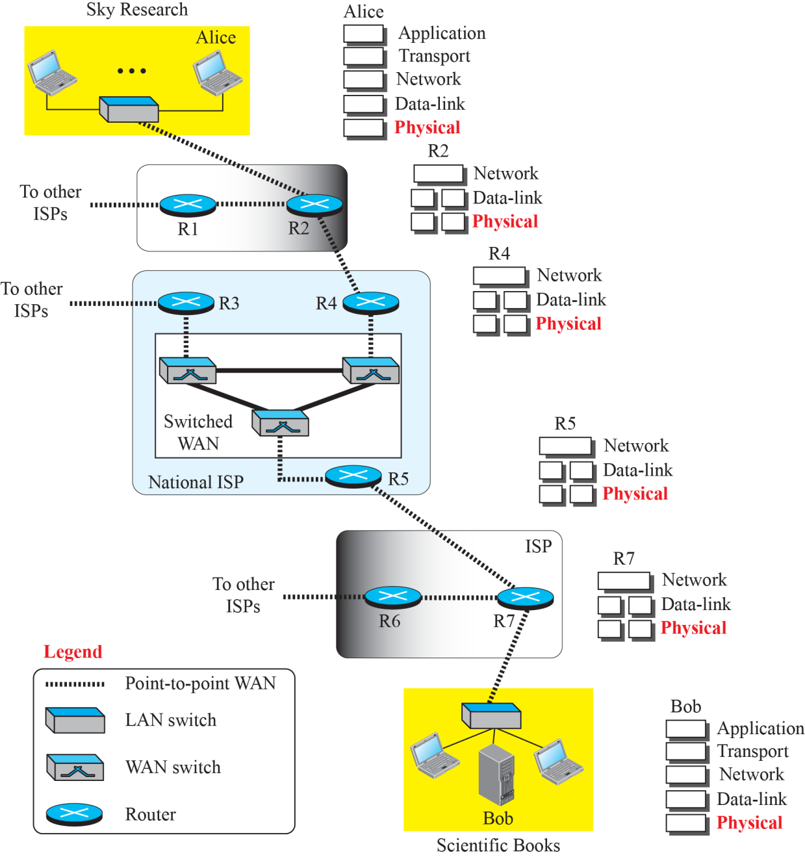
    3-1 Data and Signals
    Fig. 3.1 Communication at the physical layer

Slide 6
    3.1.1 Analog and Digital Data
    3.1.1 Analog and Digital Data
Analog data refers to information that is continuous
  Analog clock
  Human voice
Digital data refers to information that has discrete states
  Digital clock
  Data are stored in computer memory

Slide 7
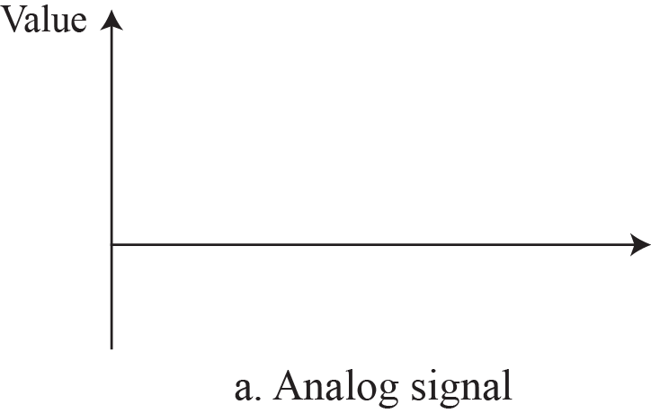
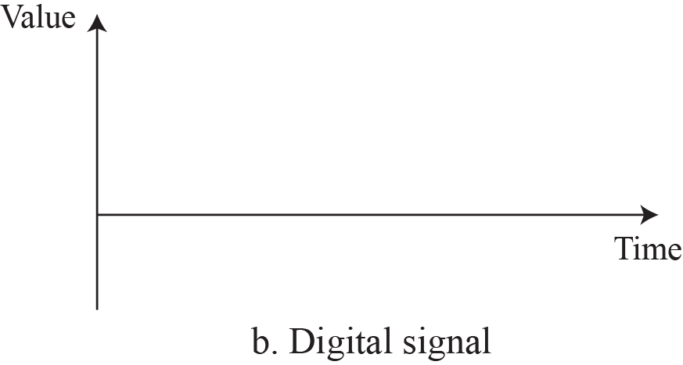
    3.1.2 Analog and Digital Signals
    3.1.2 Analog and Digital Signals
Analog signal has infinitely many levels of intensity over a period of time.
Digital signal have only a limited number of defined values.
Fig. 3.2: Comparison of analog and digital signals

Slide 8
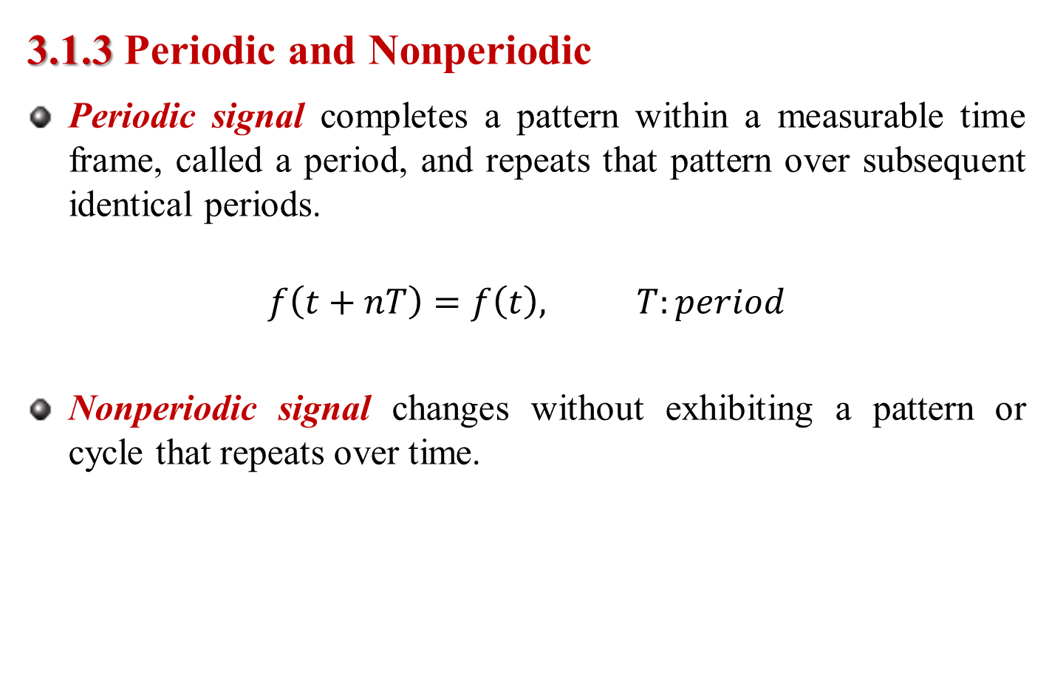
    3.1.3 Periodic and Nonperiodic
    3.1.3 Periodic and Nonperiodic
Periodic signal completes a pattern within a measurable time frame, called a period, and repeats that pattern over subsequent identical periods.
$$f\left(t+nT\right)=f\left(t\right), T:period$$
Nonperiodic signal changes without exhibiting a pattern or cycle that repeats over time.

Slide 9

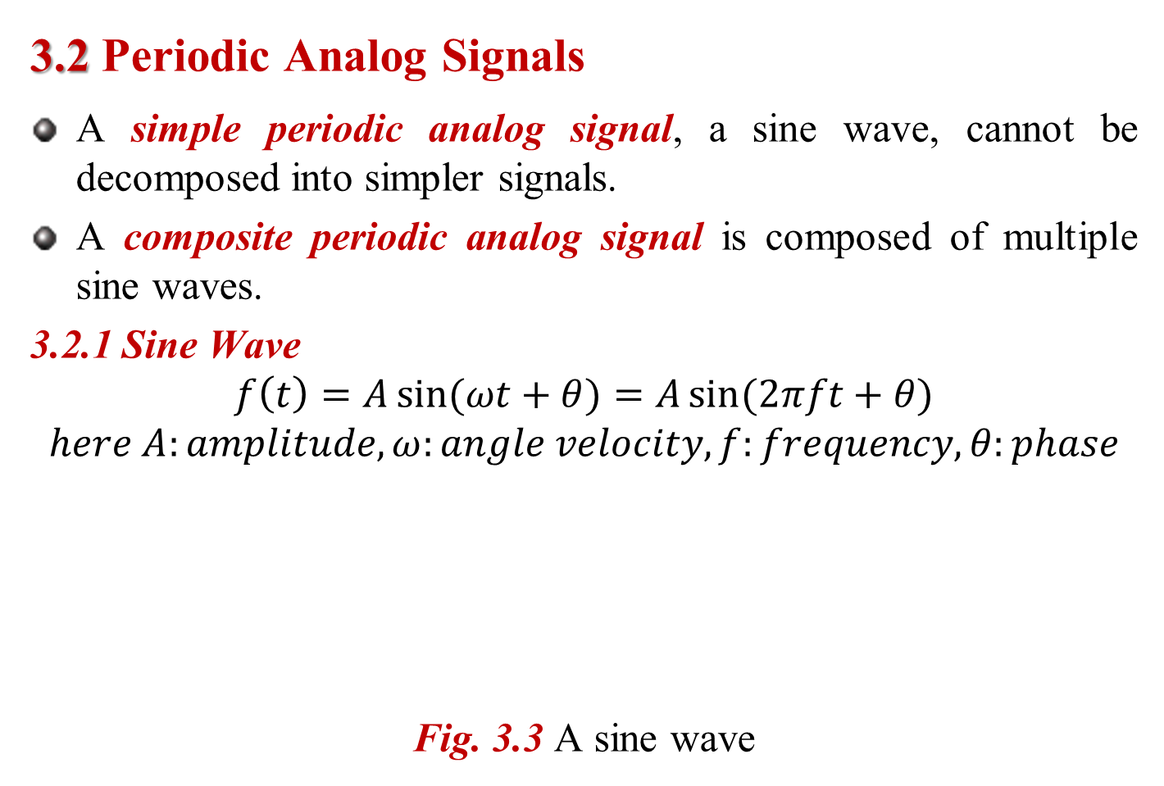
    3.2 Periodic Analog Signals
    3.2 Periodic Analog Signals
A simple periodic analog signal, a sine wave, cannot be decomposed into simpler signals.
A composite periodic analog signal is composed of multiple sine waves.
3.2.1 Sine Wave
$$f\left(t\right)=A\sin{(ωt+θ)}=A\sin{(2πft+θ)}$$
$$here A:amplitude, ω:angle velocity, f:frequency, θ:phase$$
Fig. 3.3 A sine wave

Slide 10
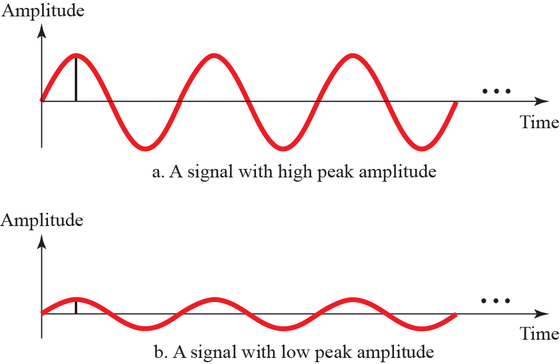
3.2.1 Sine Wave
Fig. 3.4 Two signals with two different amplitudes

Slide 11
3.2.1 Sine Wave
Ex. 3.1 rms value
The power in your house can be represented by a sine wave with a peak amplitude of 155 to 170 V. However, it is common knowledge that the voltage of the power in U.S. homes is 110 to 120 V. This discrepancy is due to the fact that these are root mean square (rms) values. The signal is squared and then the average amplitude is calculated. The peak value is equal to 2^{1/2} × rms value.
Ex. 3.2 DC
The voltage of a battery is a constant; this constant value can be considered a sine wave, as we will see later. For example, the peak value of an AA battery is normally 1.5 V.

Slide 12
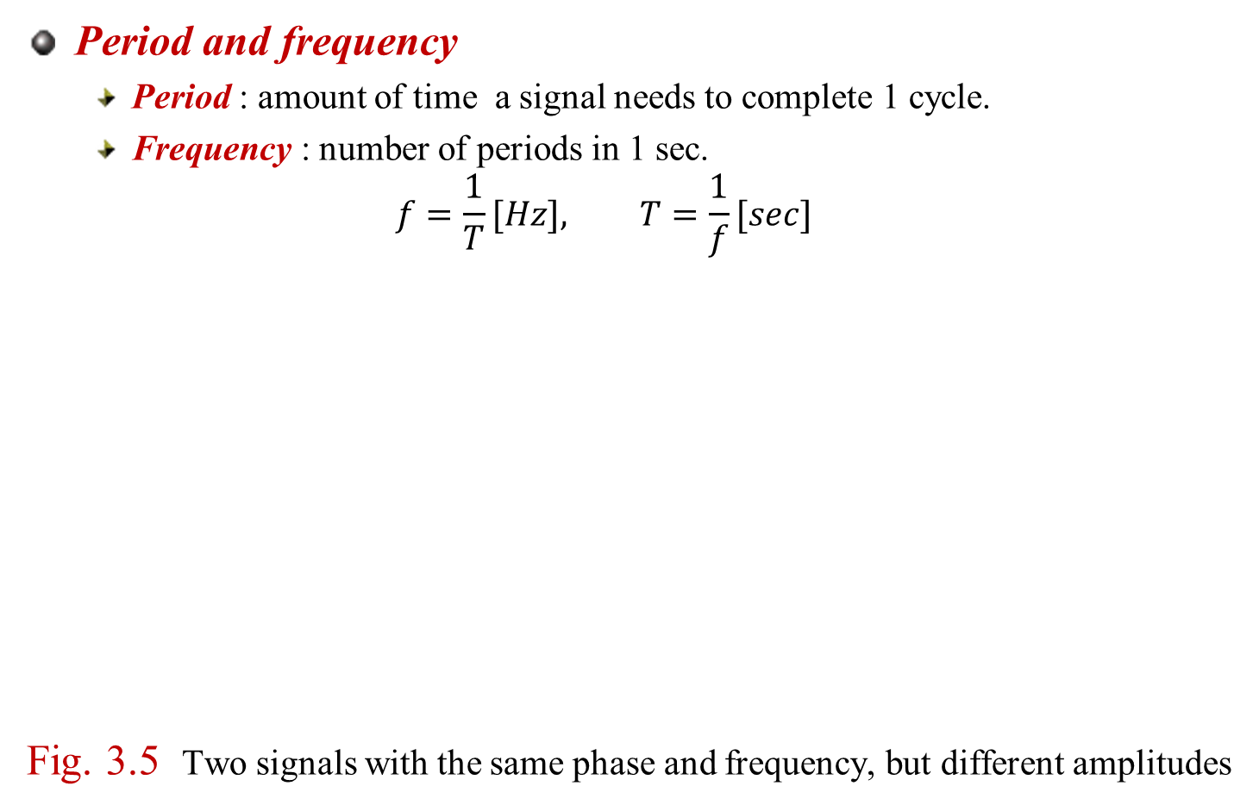
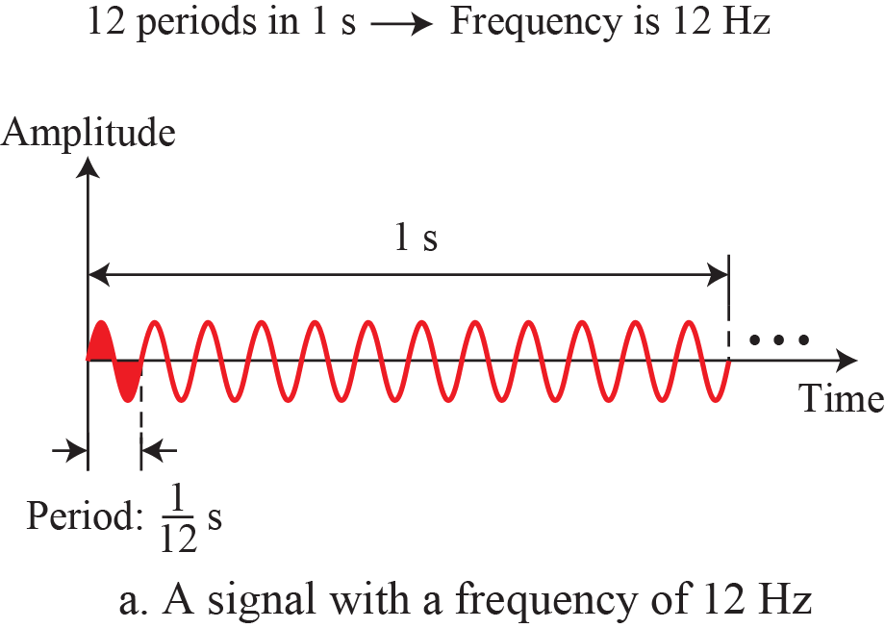
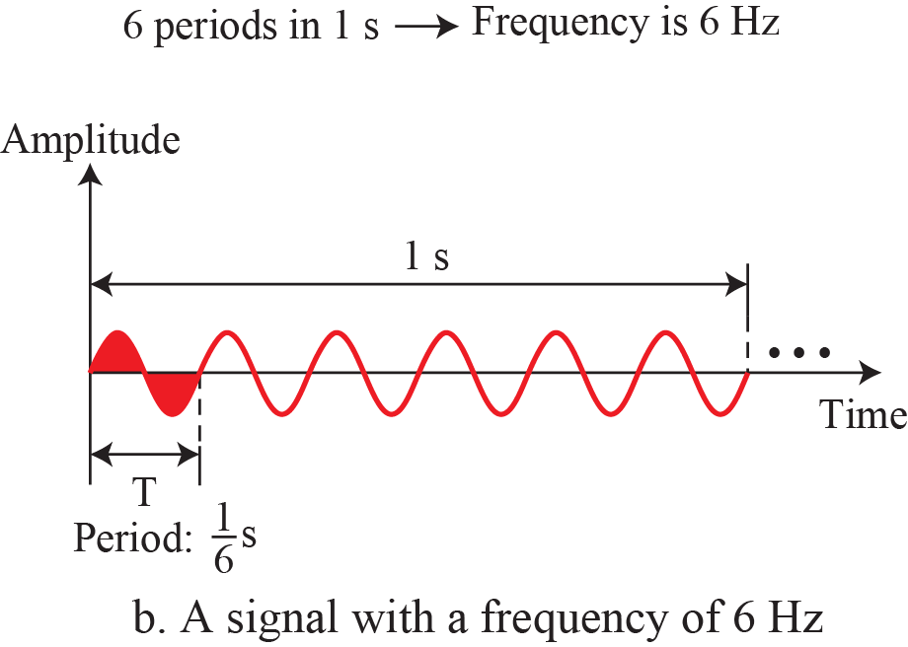
3.2.1. Sine Wave

Slide 13
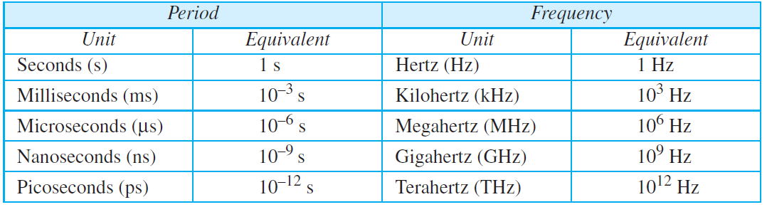
3.2.1. Sine Wave
Table 3.1 Units of period and frequency
Ex. 3.3
Ex. 3.4
Ex. 3.5
0 frequency signal?

Slide 14
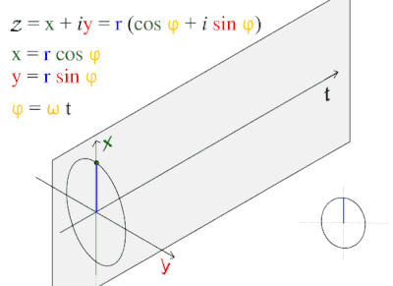
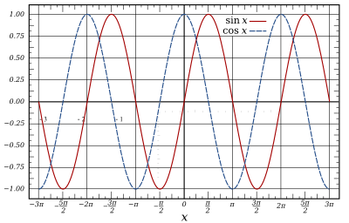
3.2.1. Sine Wave
Ex.

Slide 15
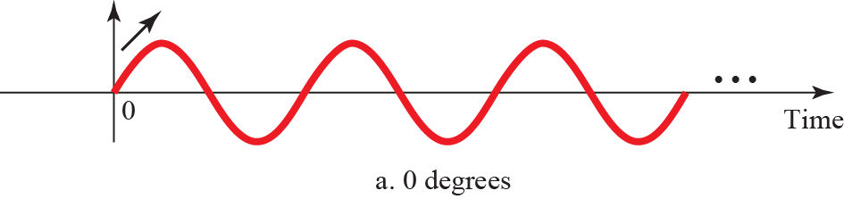
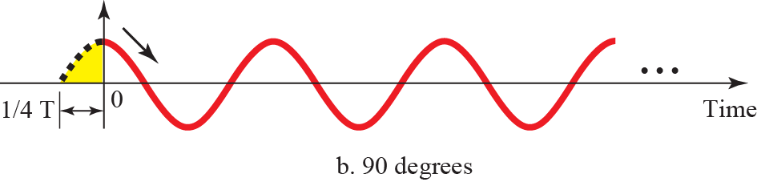
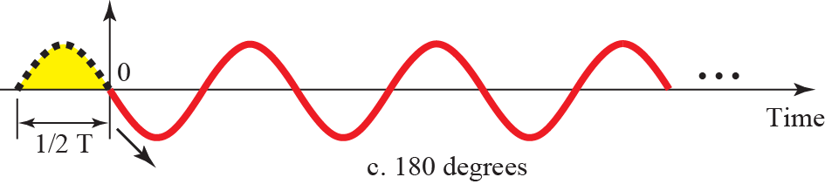
    3.2.2 Phase
    3.2.2 Phase
Phase, or phase shift, describes the position of the waveform relative to time 0.
Fig. 3.6 Three sine waves with different phases

Slide 16
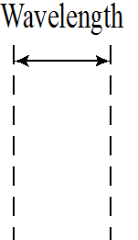

    3.2.3 Wavelength
    3.2.3 Wavelength
$$Wavelength=\left(propagation speed\right)×period$$
$=\frac{propagation speed}{frequency}$
$λ=\frac{c}{f}, c=3×{10}^{8}m/s$
Fig. 3.7 Wavelength and period

Slide 17
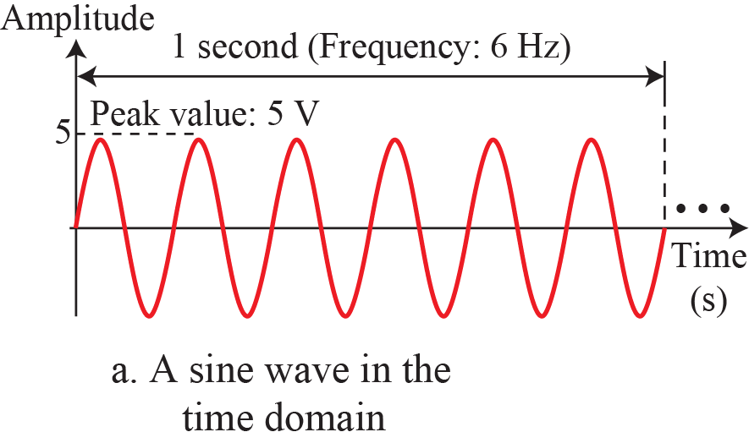
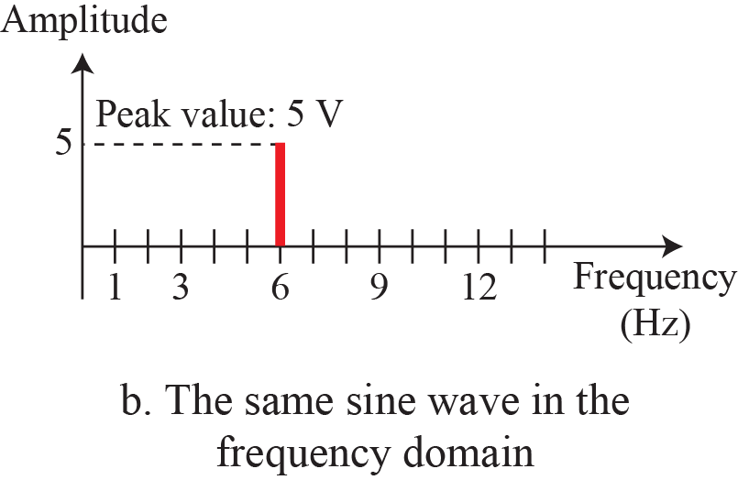
    3.2.4 Time and Frequency Domains
    3.2.4 Time and Frequency Domains
Fig. 3.8 The time-domain and frequency-domain plots of a sine wave

Slide 18
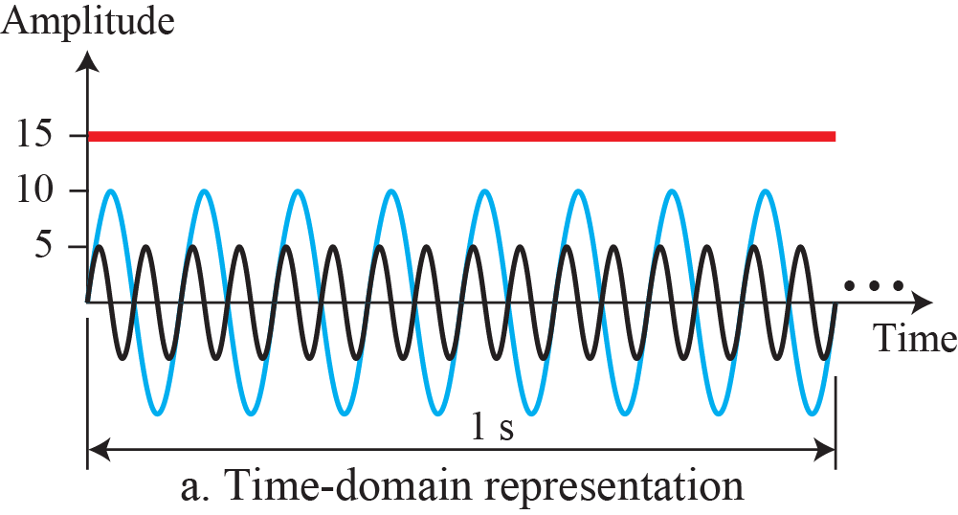
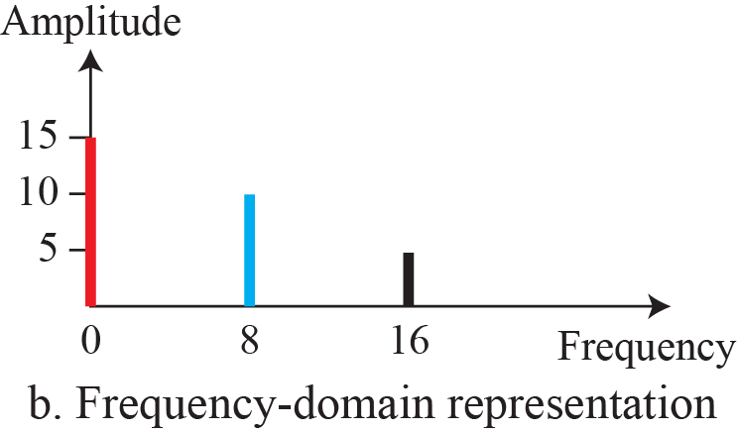
    3.2.4 Time and Frequency Domains
    Ex. 3.7
Fig. 3.9 The time domain and frequency domain of three sine waves

Slide 19
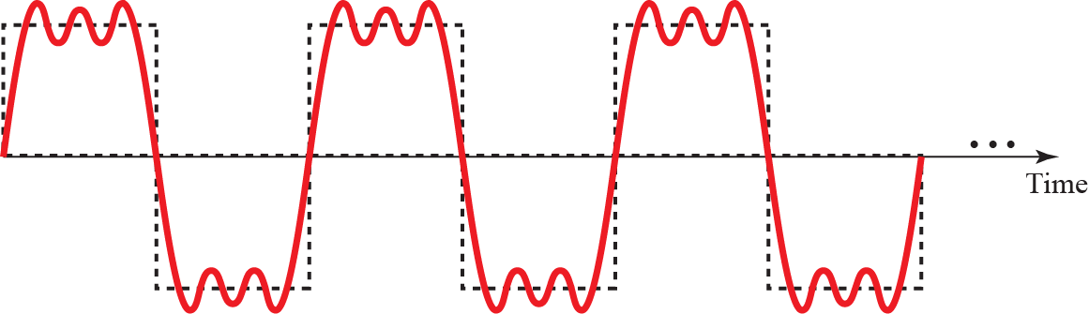
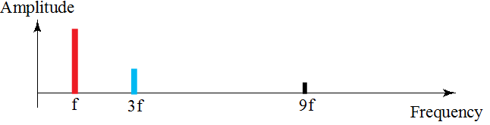
    3.2.5 Composite Signals
    3.2.5 Composite Signals
    Ex. 3.8
Fig. 3.10 A composite periodic signal
Fig. 3.11 Decomposition of a composite periodic signal

Slide 20
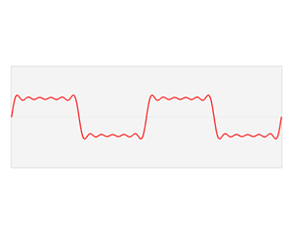
    3.2.5 Composite Signals
    Ex.

Slide 21
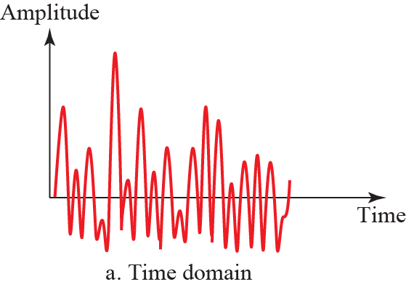
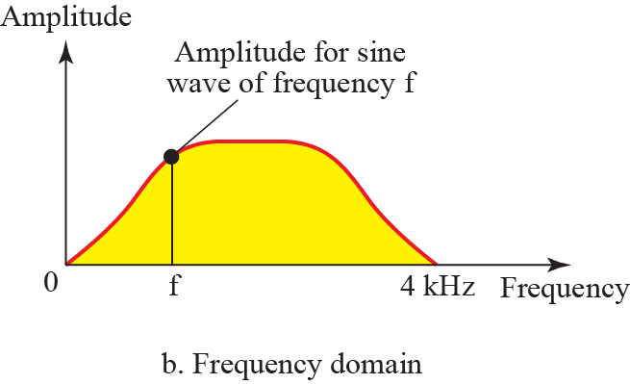
    3.2.5 Composite Signals
    Ex. 3.9
Fig. 3.12 Time and frequency domain of a non-periodic signal

Slide 22
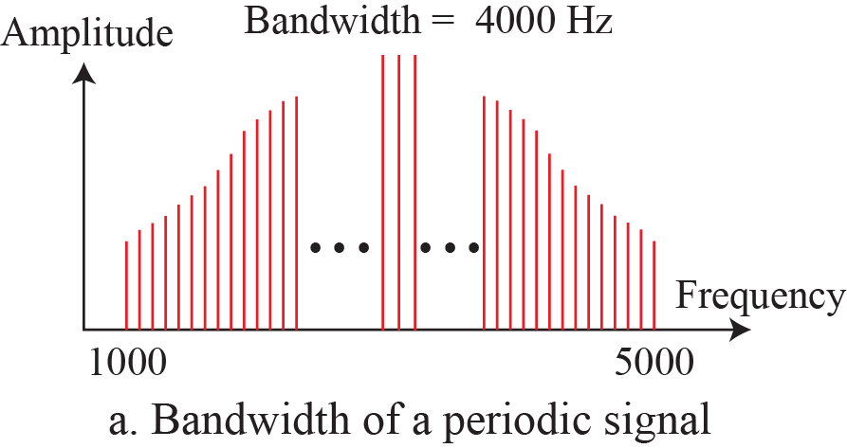
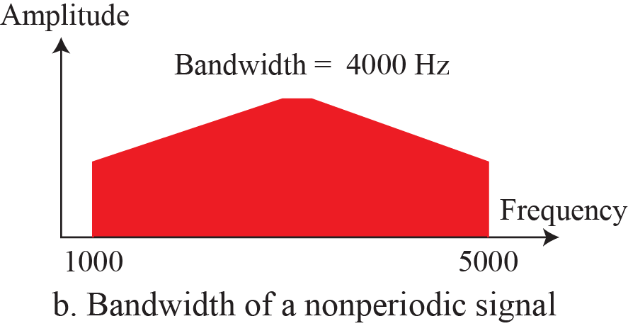
    3.2.6 Bandwidth
    3.2.6 Bandwidth
The range of frequencies contained in a composite signal is its bandwidth.
Fig. 3.13 The bandwidth of periodic and nonperiodic composite signals

Slide 23

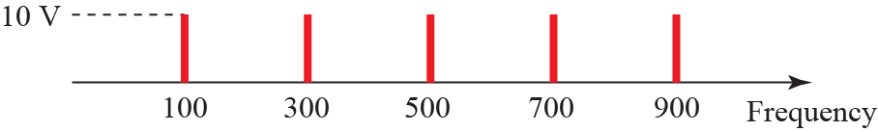

    3.2.6 Bandwidth
    Ex. 3.10
Fig. 3.14 The bandwidth for example 3.10

Slide 24
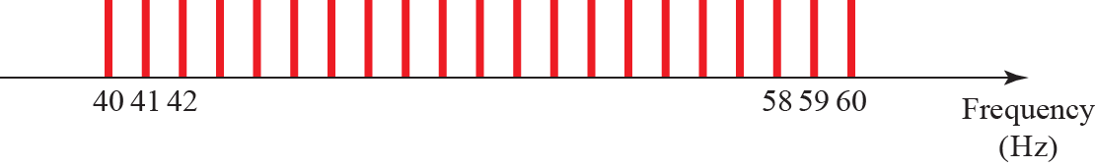
    3.2.6 Bandwidth
    Ex. 3.11
Fig. 3.15 The bandwidth for example 3.11

Slide 25
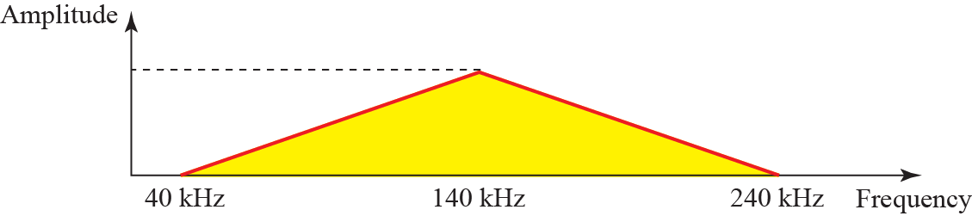
    3.2.6 Bandwidth
    Ex. 3.12
Fig. 3.15 The bandwidth for example 3.12
    Ex. 3.13 AM
    Ex. 3.14 FM
    Ex. 3.15 TV

Slide 26
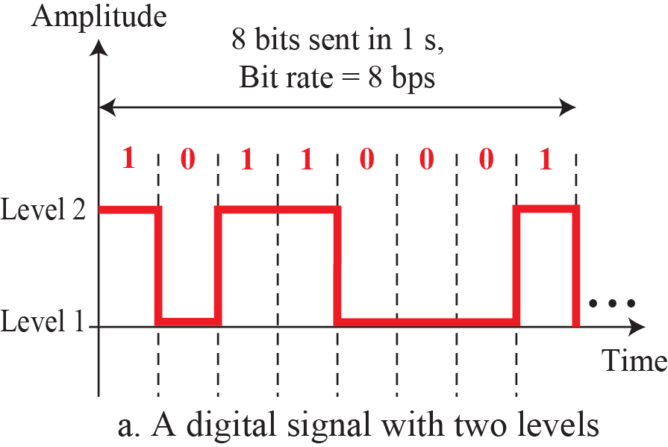
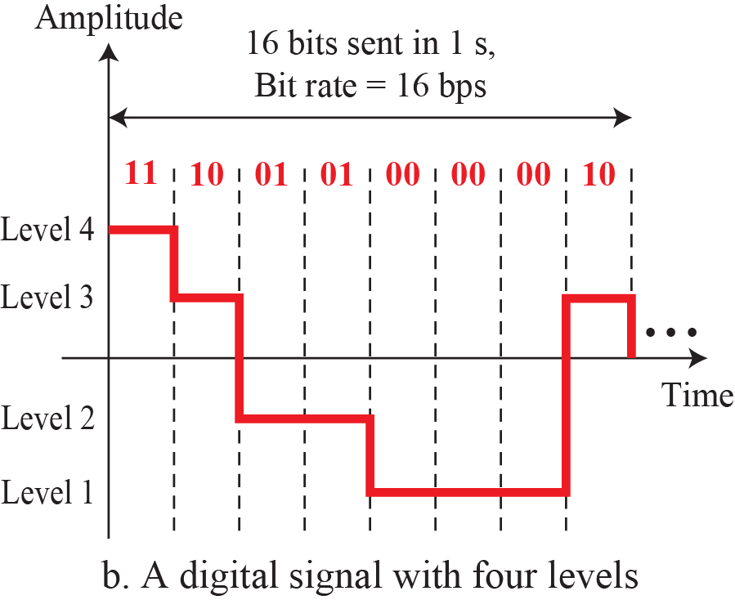

    3.3 Digital Signals
    3.3 Digital Signals
Fig. 3.17 Two digital signals: one with two signal levels and the
other with four signal levels
Ex. 3.16
Ex. 3.17

Slide 27


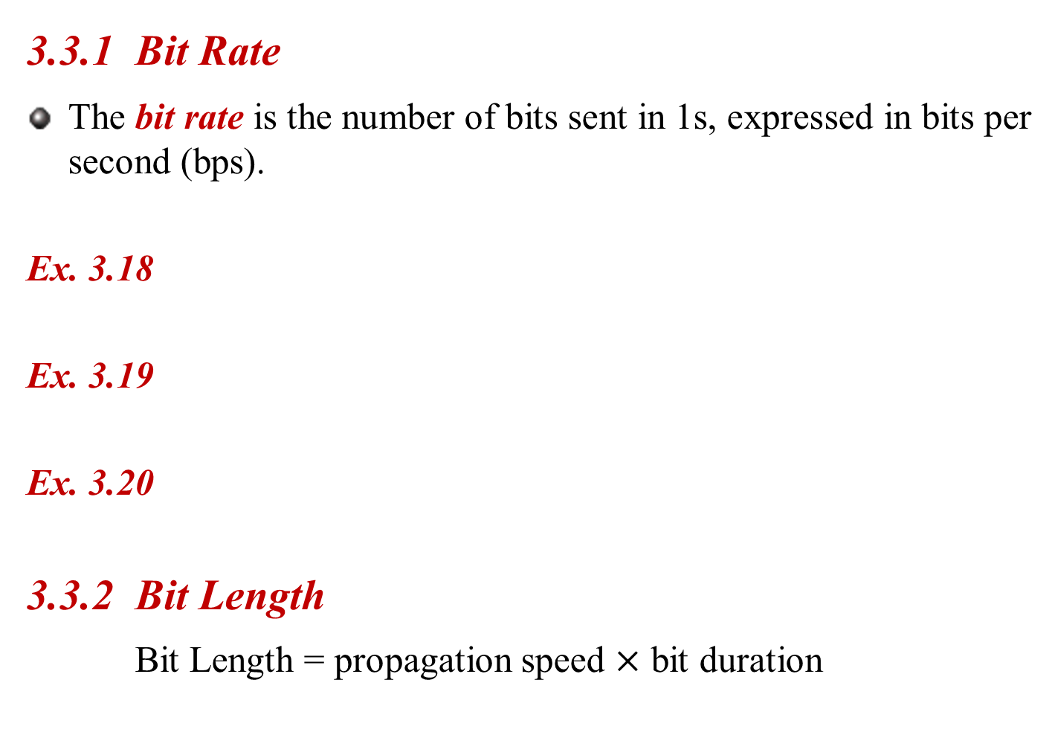
    3.3.2 Bit Length
    3.3.1 Bit Rate
The bit rate is the number of bits sent in 1s, expressed in bits per second (bps).
Ex. 3.18
Ex. 3.19
Ex. 3.20
    3.3.2 Bit Length
    Bit Length = propagation speed $×$ bit duration

Slide 28
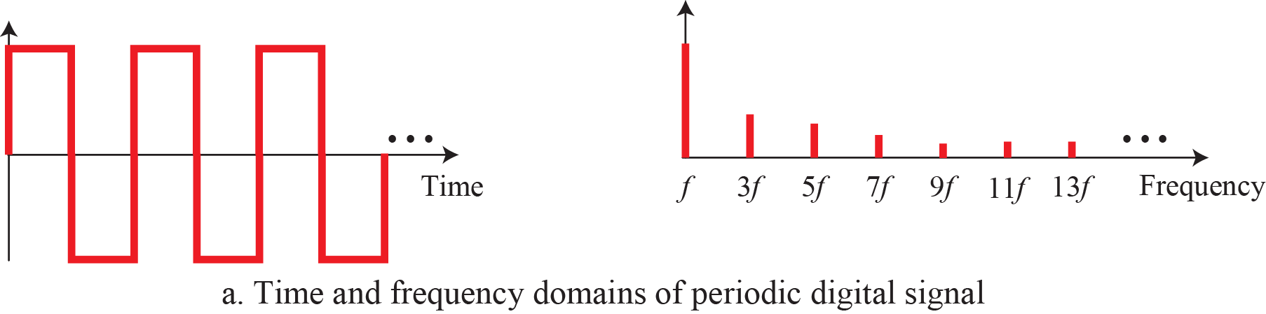
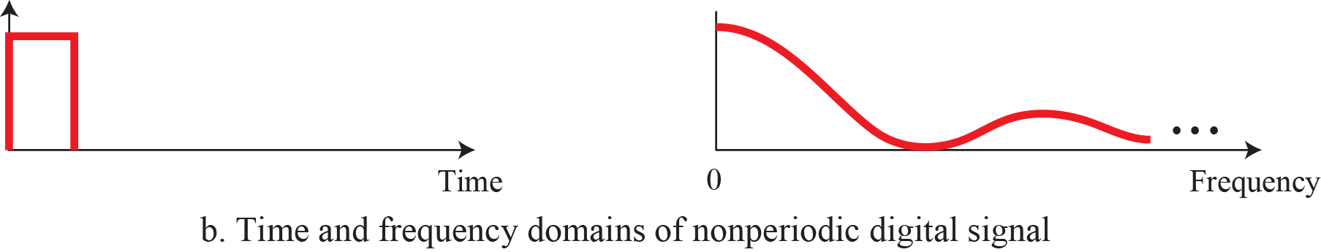
    3.3.3 Digital as Composite Analog
    3.3.3 Digital as Composite Analog
Fig. 3.18 The time and frequency domains of periodic and
nonperiodic digital signals

Slide 29
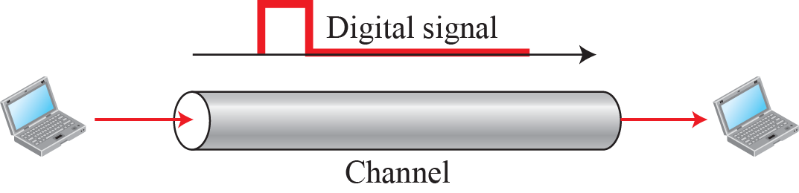
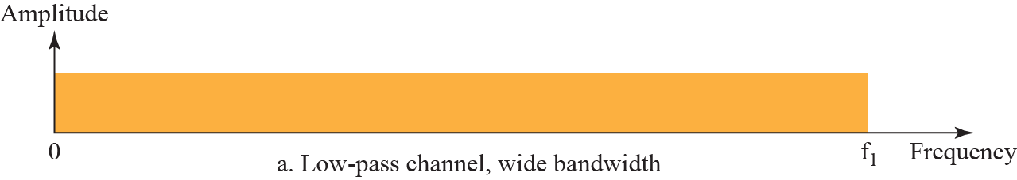
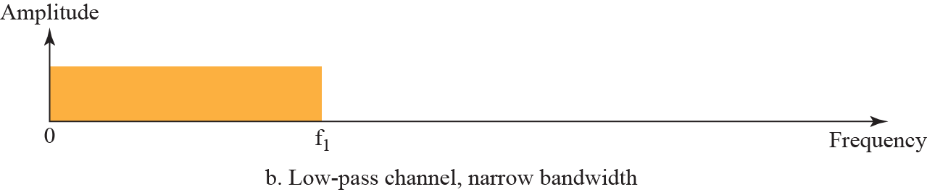
    3.3.4 Transmission of Digital Signals
    3.3.4 Transmission of Digital Signals
    Baseband Transmission
Fig. 3.19 Baseband transmission
Fig. 3.20 Bandwidth of two low-pass channels

Slide 30
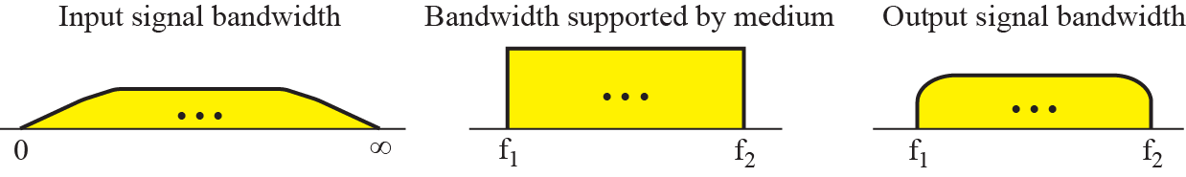
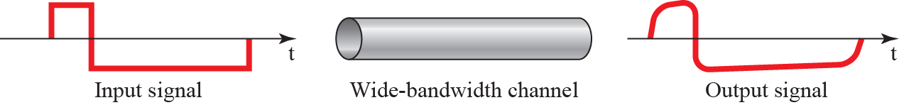
    3.3.4 Transmission of Digital Signals
    Case 1: Low-Pass channel with Wide Bandwidth
Fig. 3.21 Baseband transmission using a dedicated medium
Ex. 3.21 LAN

Slide 31
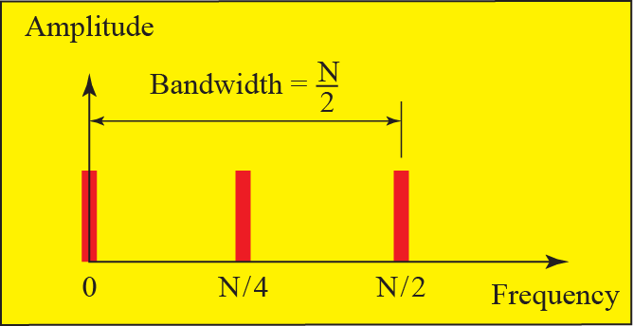

    3.3.4 Transmission of Digital Signals
    Case 2: Low-Pass channel with Limited Bandwidth
    Rough Approximation $Bandwidth= \frac{N}{2}, N:bit rate$
Fig. 3.22 Rough approximation of a digital signal (part 1)

Slide 32
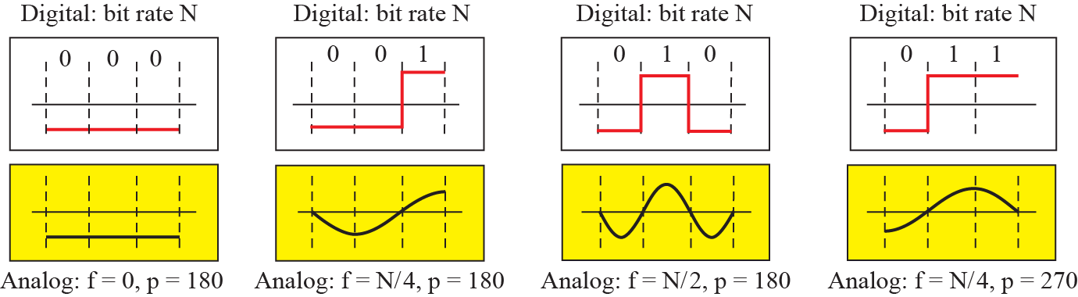
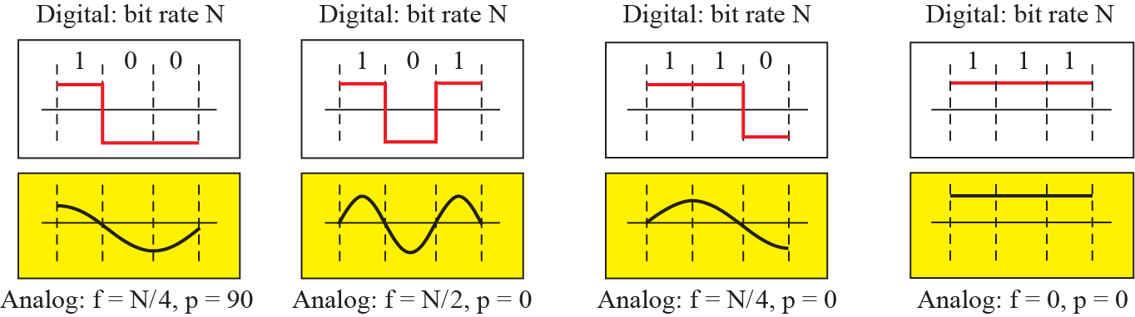
    3.3.4 Transmission of Digital Signals
Fig. 3.22 Rough approximation of a digital signal (part 2)

Slide 33
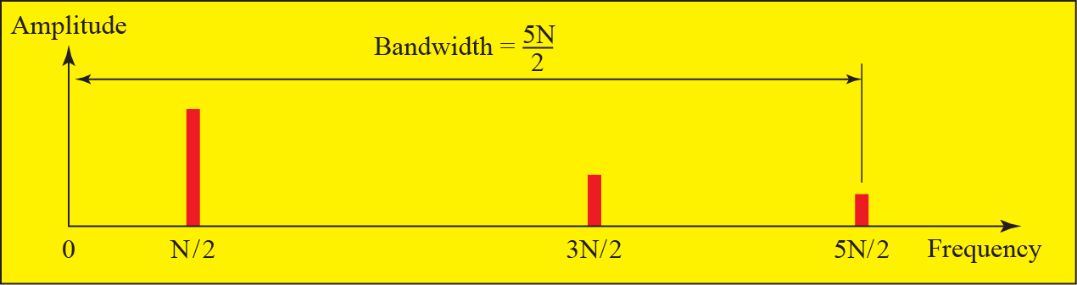
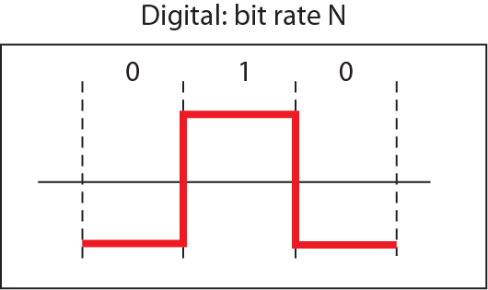
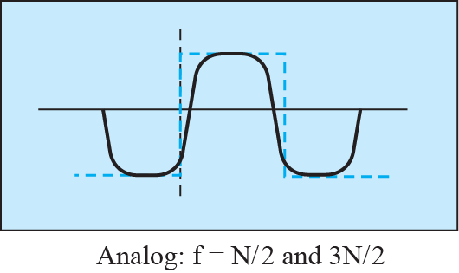
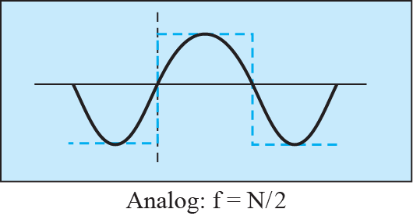
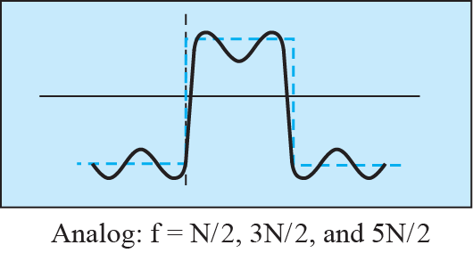
    3.3.4 Transmission of Digital Signals
    Better Approximation
Fig. 3.23 Simulating a digital signal with first three harmonics

Slide 34

    3.3.4 Transmission of Digital Signals
    Table 3.2 Bandwidth requirements
    Ex. 3.22 Required Bandwidth
    Ex. 3.23 Minimum Bandwidth

Slide 35

    3.3.4 Transmission of Digital Signals
    Broadband Transmission(Using Modulation)
Fig. 3.24 Bandwidth of a band-pass channel

Slide 36







    3.3.4 Transmission of Digital Signals
    Broadband Transmission(Using Modulation)
Fig. 3.25 Modulation of a digital signal for transmission on band-pass channel
Ex. 3.24
Ex. 3.25

Slide 37

    3.4 Transmission Impairment
    3.4 Transmission Impairment
Imperfection of transmission media causes signal impairment.
Attenuation, distortion, and noise
Fig. 3.26 Causes of impairment

Slide 38




    3.4 Transmission Impairment
    3.4.1 Attenuation
Attenuation means a loss of energy.
  Overcoming the resistance of the medium.
  To compensate for this loss, amplifiers are used.
Fig. 3.27 Attenuation and amplification

Slide 39




    3.4 Transmission Impairment
    Decibel$dB=10\log_{10}\frac{P_{2}}{P_{1}}$
Ex. 3.26
Ex. 3.27
Ex. 3.28
Fig. 3.28 Decibels for Example 3.28

Slide 40


    3.4 Transmission Impairment
Ex. 3.29 ${dB}_{m}=10\log_{10}P_{m}$
Ex. 3.30

Slide 41


    3.4 Transmission Impairment
    3.4.2 Distortion
Distortion means that the signal changes its form or shape.
  Composite signal
  Different delay in arriving
Fig. 3.29 Distortion

Slide 42



    3.4 Transmission Impairment
    3.4.3 Noise
Several types of noise
  thermal noise
  induced noise
  crosstalk
  impulse noise
Fig. 3.30 Noise

Slide 43



    3.4 Transmission Impairment
    Signal to Noise Ratio (SNR)
    $$SNR=\frac{Average signal Power}{Average Noise Power} {SNR}_{dB}=10 \log_{10}{SNR}$$
Ex. 3.31
Ex. 3.32
Fig. 3.31 Two cases of SNR: a high SNR and a low SNR

Slide 44

    3.5 Data Rate Limits
    3.5 Data Rate Limit
Data rate depends on
  Bandwidth
  Level of the signals
  Quality of the channel (level of noise)
3.5.1 Noiseless Channel: Nyquist Rate
here L is the number of level
Ex. 3.33
Ex. 3.34 $R=2×3000 ×\log_{2}{2}=6000bps$
Ex. 3.35 $R=2×3000 ×\log_{2}{4}=12000bps$
Ex. 3.36 $265,000=2×20,000 ×\log_{2}{L}→×\log_{2}{L}=6.625$
$$∴L=2^{6.625}=98.7level$$
Bit Rate = 2 × bandwidth ×log₂L R=2B log₂ L

Slide 45
    3.5 Data Rate Limits
3.5.2 Noisy Channel: Shannon Capacity
Ex. 3.37 C = B log₂(1+S/N) = B log₂(1+0) = 0
Ex. 3.38 C = 3000 log₂(1+3162) = 3000 × 11.62 = 34,860 bps
Ex. 3.39 SNR_{dB} = 10 log₁₀SNR → SNR = 10^{SNRdB/10}
→ SNR = 10^{3.6}= 3981
C = 2 × 10⁶ × log₂(3982) = 24 Mbps
Ex. 3.40 C = 2MHz × (36/3) = 24 Mbps
Capacity = bandwidth × log₂(1+SNR) C = B log₂(1+S/N)

Slide 46
    3.5 Data Rate Limits
3.5.3 Using Both Limits
Ex. 3.41 C = 10⁶ × log₂(1+63) = 6 Mbps
4 Mbps = 2 × 1 MHz × log₂L
∴ L = 4
The Shannon capacity gives us the upper limit;
the Nyquist formula tells us how many signal levels we need.

Slide 47
    3.6 Performance
    3.6 Performance
3.6.1 Bandwidth
Bandwidth in Hz
  Range of frequencies in a composite signal or
  range of frequencies that a channel can pass
Bandwidth in Bits per Seconds
  The speed of bit transmission in a channel or link
Ex. 3.42
Ex. 3.43

Slide 48
    3.6 Performance
3.6.2 Throughput
a measure of how fast we can actually send data through a network.
T always less than B.
3.6.3 Latency (Delay)
how long it takes for an entire message to completely arrive at the destination from the time the first bit is sent out from the source.
Latency = propagation time + transmission time
+ queuing time + processing delay
Ex. 3.45
Ex. 3.46
Ex. 3.47

Slide 49

    3.6 Performance
3.6.4 Bandwidth – Delay Product
The number of bits that can fill the link
Fig. 3.32 Filling the links with bits for Case 1

Slide 50
    3.6 Performance
Fig. 3.33 Filling the links with bits for Case 2
Ex. 3.48

Slide 51



    3.6 Performance
Fig. 3.34 Concept of bandwidth-delay product
3.6.5 Jitter
  is a problem if different packets of data encounter different delays and the application using the data at the receiver site is time-sensitive (audio and video data, for example).

Slide 52
    Homework
Homework
Read textbook pp. 96-129
Solve Problems p3-4, p3-5, p3-7, p3-10, p3-13, p3-17, p3-21,
p3-26, p3-29, p3-33
Next Lecture
Chapter 4. Digital Transmission

